Slide 1
ARI702 Artificial Intelligence
Expert Systems and Planning

Slide 2
Expert Systems
ES perform tasks for specific domains that require human expertise
Medical diagnosis, fault diagnosis, status monitoring, data interpretation, computer configuration, etc.
ES solve problems using domain-specific knowledge
Domain knowledge is acquired by interviewing human experts
ES cannot operate in situations requiring common sense

Slide 3
Rule-Based Systems
Control scheme “interpreter”
condition
action
Rule n:
IF condition1
condition2
…
THEN
action1
action2
…
condition
action
antecedent
condition
action
…
…
consequent
Database of facts “Working memory”
When one part of the IF portion matches a fact in working memory, the antecedent is SATISFIED. When all antecedents are satisfied, the rule is TRIGGERED. When the consequent of a rule is performed, the rule is FIRED.

Slide 4
Three Phases
Match phase
Match left side of rules (antecedents) with facts in working memory
Unification
Conflict resolution
Of all the rules that are triggered, decide which rule to fire.
Some strategies include:
Do not duplicate rule with same instantiated arguments twice
Prefer rules that refer to recently created WM elements
Prefer rules that are more specific (antecedents are more constraining)
Prefer Mammal(x) & Human(x) -> add Legs(x,2) over Mammal(x) -> add Legs(x,4)
If rules are ranked, fire according to ranking
Act phase
Add or delete facts to WM as specified by rule consequent

Slide 5
Expert Systems at a Glance
ES are one of AI's early showpieces
ES use rule-based systems along with additional capabilities
Components of an ES include:
Evidence gathering
Control of inference
Uncertainty reasoning
Explanation generation and tutoring
User interface
Validation
Social issues

Slide 6
Some Famous Early Expert Systems
Dendral (Stanford, Ed Feigenbaum, 1965) - organic chemical analysis
Macsyma (MIT, 1965) - symbolic math problems
Mycin (Stanford, 1972) - diagnose blood diseases
Prospector (SRI, 1972) - mineral exploration
Caduceus (1975) - internal medicine
Xcon and R1 (1980, 1982) - computer system configuration (for DEC)
Harpy - document retrieval
Hearsay - Speech understanding
Max (Nynex, 1992) - telephone network troubleshooting bacterial infection diagnosis

Slide 7
Examples
Expert System Applet
Aaron, Artist Expert System
Some expert system shells
CLIPS
KEE
JESS

Slide 8
Mycin Example
Rules
PREMISE ($AND (SAME CNTXT GRAM GRAMNEG)
(SAME CNTXT MORH ROD)
(SAME CNTXT AIR AEROBIC))
ACTION: (CONCLUDE CNTXT CLASS ENTEROBACTERTIACEAE .8)
If the stain of the organism is granmeg, and
the morphology of the organism is rod, and
the aerobiticity of the organism is aerobic
Then there is strongly suggestive evidence (.8) that
the class of organism is enterobacteriaceae
Data
ORANISM-1:
GRAM = (GRAMNEG 1.0)
MORP = (ROD .8) (COCCUS .2)
AIR = (AEROBIC .6) (FACUL .4)

Slide 9
Forward Chaining and Backward Chaining
There are two main types of control schemes that are applied to rule-based systems.
Z1 If ?x has hair
Then ?x is a mammal
Z2 If ?x gives milk
Then ?x is a mammal
Z3 If ?x has feathers
Then ?x is a bird
Z6 If ?x is a mammal
?x has pointed teeth
?x has claws
?x has forward-pointing eyes
Then ?x is a carnivore
Z8 If ?x is a mammal
?x chews cud
Then ?x is an ungulate
Z11 If ?x is an ungulate
?x has long legs
?x has long neck
?x has tawny color
?x has dark spots
Then ?x is a giraffe
Database
------------
F1) Stretch has hair
F2) Stretch chews cud
F3) Stretch has long legs
F4) Stretch has a long neck
F5) Stretch has tawny color
F6) Stretch has dark spots

Slide 10
Forward Chaining
Reason FORWARD from facts/rules to (hopefully) a needed goal
Use modus ponens to generate new facts
Rule antecedents are compared with facts from database
If match, add consequents to database
Repeat as long as needed
Forward chaining is “data driven”
Match Z1 & F1
Add: Stretch is a mammal
Match Z8/1 & F7 (?x Stretch)
Match Z8/2 & F2
Add: Stretch is an ungulate
Note: Z5/1, Z6/1, Z7/1 would be
matched before Z8/1
Match Z11/1 & F8 (?x Stretch)
Match Z11/2 & F3
Match Z11/3 & F4
Match Z11/4 & F5
Match Z11/5 & F6
Add: Stretch is a giraffe

Slide 11
Backward Chaining
Reasons BACKWARD from goal through rules to facts
Use modus ponens
Start at goals
Match goals to consequents or facts
If match consequents, antecedents become new subgoals
Repeat until
All subgoals are proven or
At least one subgoal cannot be proven
Backward chaining is “goal driven”

Slide 12
Backward Chaining Example
Goal 1: Stretch is a giraffe
Match: Goal 1 and Z11/C (does not match with any facts)
Subgoal 2: Stretch is an ungulate
Subgoal 3: Stretch has long legs
Subgoal 4: Stretch has long neck
Subgoal 5: Stretch has tawny color
Subgoal 6: Stretch has dark spots
Match: Subgoal 2 and Z8/C (does not match with any facts)
Subgoal 7: Stretch is a mammal
Subgoal 8: Stretch chews cud
Match: Subgoal 7 and Z1/C (does not match with any facts)
Subgoal 9: Stretch has hair
Match: Subgoal 9 and F1
Subgoals 9, 7, met
Match: Subgoal 8 and F2
Subgoals 8, 2 met
Match: Subgoal 3 and F3
Subgoal 3 met
Match: Subgoal 4 and F4
Subgoal 4 met
Match: Subgoal 5 and F5
Subgoal 5 met
Match: Subgoal 6 and F6
Subgoal 6 met, Goal 1 met

Slide 13
Forward Chaining vs. Backward Chaining
High fan out - use backward chaining
Human(Albert)
Human(Alfred)
Human(Barry)
Human(Charlie)
...
Human(Highlander)
...
100) Human(Shaun)
...
500) Human(Zelda)
501) Human(x) -> Mortal(x)
502) Mortal(x) -> CanDie(x)
Can we kill Shaun Connery?
FC
503) Mortal(Albert)
504) Moral(Alfred)
…
1003) CanDie(Albert)
1004) CanDie(Alfred)
…
1100) CanDie(Shaun)
BC
Prove: CanDie(Shaun)
Match: Goal and 502/C
Prove: Mortal(Shaun)
Match: Mortal(Shaun) and 501/C
Prove: Human(Shaun)
Match: Human(Shaun) and 100
Done!

Slide 14
Forward Chaining vs. Backward Chaining
Forward chaining may generate a lot of useless facts
If ?x has feathers
Than ?x can fly
If ?x has feathers
Then ?x is a bird
…
1 condition – many actions
If ?x has feathers
Then ?x can be used as a pen
Use BC!

Slide 15
Forward Chaining vs. Backward Chaining
High fan in – use forward chaining
Potential problem with BC
If many subgoals, each must be examined
If ?x has feathers
?x is brown
?x sings @#!@#! Patterns
?x sleeps on one foot
?x makes good pot pie
?x lives in tree
Then ?x is bird
Many conditions – 1 action
If time is crucial and you only have 1 goal to prove, use BC
If you have extra time and want to be prepared for future questions, use FC to generate all possible facts
Or use bi-directional search

Slide 16
Limitation of ES
A lot of matches!
May perform many matches for Rule 1, then have to perform same matches for Rule 2 (should share partial match information)
May match first few antecedents, but fail on last If last antecedent added later, have to start again at beginning of rule (should save partial match information)
One solution: RETE net (RETE stands for ``network'')
Contains:
alpha nodes (one for each antecedent)
beta nodes (combination of matches)
terminal nodes (one for each rule)
Explicitly store shared and partial match information
Machine rules and facts are numerous, matching is laborious
Much redundant work in match phase
RETE representation eliminates some redundant work

Slide 17
RETE Network
Rule 1 Rule 2
if ?x is small A1 if ?x is small
?y is larger than ?x A2 ?x lives on land
?y is a carnivore A3 ?y is strong
then ?y eats ?x (ADD) ?y is a carnivore
then ?y eats ?x (ADD)
Working Memory:
rabbit is small
sheep is small
bird is small
mouse is small
lion is a carnivore
tiger is a carnivore
lion is larger than rabbit
lion is larger than fish
lion is larger than sheep
tiger is larger than rabbit
giraffe is larger than rabbit

Slide 18
RETE Network
For each rule
For each antecedent
Create alpha node
Store antecedent matches in this node
For each alpha node except the first
Create beta node
If this is the first beta node in the network
Then parents are alpha1 and alpha2
Else parents are previous beta and next unmatched alpha
Store partial matches in this node
Create terminal node for each rule
Parent is last beta for the rule
To run
Distribute assertions to top of network
Match assertions with alpha nodes - pass bindings to beta nodes
For each beta node, JOIN by checking for consistent bindings
When an assertion (binding list) hits terminal node, change WM
For each WM change, add information to alpha node and propagate down
Do this for additions and deletions

Slide 19
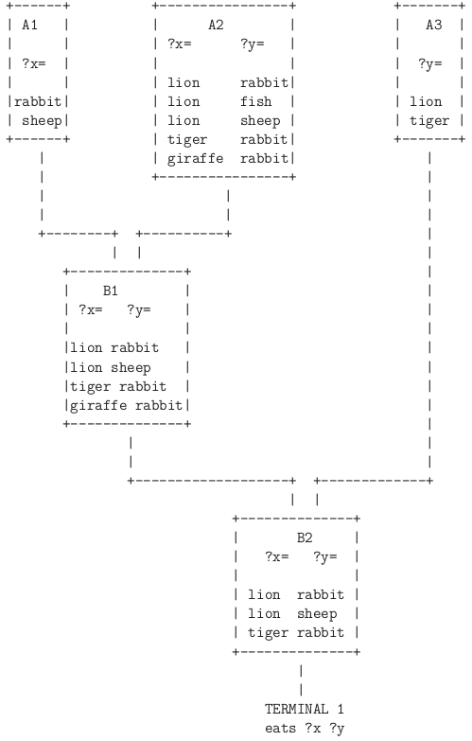
RETE Network

Slide 20
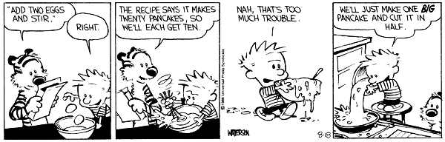
Planning
What is planning?
Strategies required to achieve a goal or to solve a particular problem

Slide 21
Need for Planning
If our goal is to create an autonomous, intelligent entity, we need to study planning.
Logic, natural language, learning, vision, are all useful, and they would make nice human-driven tools.
But what is the entity going to DO???
It has to decide WHAT it wants to do, and HOW to do it.

Slide 22
Environment Properties
Fully observable vs. partially observable
Deterministic vs. stochastic / strategic
Episodic vs. sequential
Static vs. dynamic
Discrete vs. continuous
Single agent vs. multiagent
Notes:
Fully observable vs. partially observable
Environment sensors provide access to complete state of the
relevant environment at each point in time
Deterministic vs. stochastic / strategic
If next state completely determined by current and action,
then deterministic, otherwise stochastic
If deterministic except for actions of other agents,
then strategic
Episodic vs. sequential
Episodic, action choice depends only on current state
Sequential, current action may affect future actions
Static vs. dynamic
Dynamic, environment can change while agent is deliberating
Discrete vs. continuous
Applied to state, time, percepts, or actions
The way the information is represented
Single agent vs. multiagent
How distinguish agent from environment?
if other's behavior maximizes its performance based on
agent, then it is multiagent

Slide 23
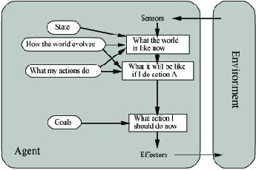
Goal-Based Agents
Goal reflects desires of agents
May project actions to see if consistent with goals
Takes time, world may change during reasoning

Slide 24
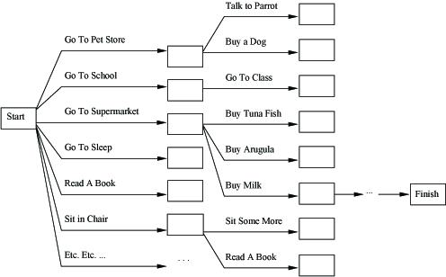
Planning Search Space
Suppose problem is “Get a quart of milk and two eggs (to make pancakes) and a variable-speed cordless drill (to fix house when done)”.
Search through a space of states
Try each possible action
Thousands of actions, millions of states
The heuristic function directs search, but doesn't prune states

Slide 25
Planning Key 1
In planning we will modify our representation of the search space (states, goals, and actions) to allow more efficient reasoning.
Instead of search through states from initial state to goal state, we can look for actions that seem relevant and are accessible.
If goal includes Have(Milk)
and Buy(x) achieves Have(x)
then agent should consider plan that includes Buy(Milk).
Do not consider Buy(WhippingCream) or GoToSleep.

Slide 26
Planning Key 2
The planner can add actions to the plan wherever they are needed, instead of always at the end (or beginning) of the plan.
Agent may want to Buy(Milk), but doesn't know how to get there, how to buy it, what to do after that.
Make “obvious” or “important” decisions first.

Slide 27
Planning Key 3
Parts of the world are independent from other parts.
We can solve one part of a conjunctive goal with one plan, another part of the goal with another plan.

Slide 28
Planning Representation
States are represented as a conjunction of instantiated literals (no functions)
At(Home) ^ Have(Milk) ^ Have(Bananas) ^ Have(Drill) ^ …
States can be incomplete - if don't specify, then negation is assumed.
If Have(Unicorn) is not included, assume -Have(Unicorn). This is the Closed-World Assumption.
Goals are described as conjunction of literals (possibly with variables).
At(Home) ^ Have(Milk) ^ Have(Bananas) ^ Have(Drill)
At(x) ^ Sells(x, Milk) if goal is to be at store that sells milk.
Variables must be existential (like theorem prover goal).
Here, we are not seeing if database entails goal.
We are trying to transform state to one that includes goal.

Slide 29
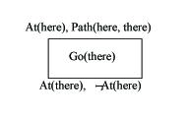
Planning Representation
STRIPS Operators
Precondition
Conjunction of atoms (positive literals) that must be true to apply operator
Effect
Conjunction of literals that describe how the situation changes when operator is applied
Example
OP Go(?there)
Precondition: At(?here) ^ Path(?here, ?there)
Effect: At(?there) ^ -At(?here)

Slide 30
State Space Planner
Operators can have variables - then we unify goals with facts.
We call this type of planner a situation space planner, or state space planner, because nodes in search space represent states or situations.
This type of planner completely solves one goal, then tacks on plan for next goal.
“Progression planner” if search forward (A*) This prunes options if high fan-in
“Regression planner” if search backward (GPS) This prunes options if high fan-out

Slide 31
Example State Space Planner
General Problem Solver, GPS
Uses Means-Ends Analysis

Slide 32

Limitations
Note what happens when we apply STRIPS planning to this problem.
On(C,A)
On(A,Table)
On(B,Table)
Clear(C)
Clear(B)
On(A,B)
On(B,C)
Operator PutOn(X,Y)
Prec: Clear(X)
Y=Table v Clear(Y)
On(X,Y)
Add: On(X,Y)
Clear(Z) (if On(X,Z))
Delete: On(X,~)
Clear(Y)
Approach 1
ON(A,B)
Try PutOn(C,Table) to clear A
PutOn(A,B) to achieve first goal
ON(B,C)
To achieve this goal, B will be re-cleared,
undoing first goal!
Approach 2
ON(B,C)
Try PutOn(B,C)
ON(A,C)
We are farther from this goal now than
we were in the initial state!
Sussman’s Anomaly

Slide 33
A
C
B

Slide 34
Sussman’s Anomaly
This problem can be solved, but it cannot be attacked by first applying all the operators to achieve one goal, and then applying operators to achieve another goal.
The problem is that we have forced an ORDERING on the operators. Sometimes steps for multiple goals need to be interleaved.
Partial-order planning is a type of plan generation in which ordering is imposed on operators ONLY when it has to be imposed in order to achieve the goals.

Slide 35
Plan Space Planning
Node (state space): world state
Node (plan space): partial plan
Operator (state space): next step in plan sequence
Operator (plan space)
Add a link from existing action to open condition (precondition that is not yet fulfilled)
Add a plan step to fulfill open condition
Order a step in the sequence
Gradually move from incomplete/vague plans to complete plans. We call planners that use this type of approach partial-order planners
Example: Have shoes on both feet.

Slide 36
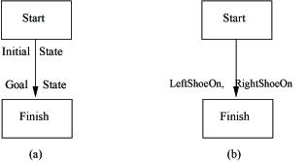
Partially-Ordered Plans
The initial plan has only two steps (Start and Finish), 1 ordering (Start before Finish).
A sock must be put on before a shoe.

Slide 37
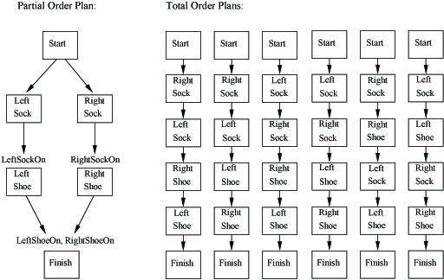
Partially-Ordered Plans
One partial-order plan can have many linearizations (total orderings), as seen in this example.

Slide 38
Partially-Ordered Plans
A plan in this scenario consists of the following components:
Set of plan steps
Set of ordering constraints (Step I must occur before Step j)
Variable binding constraints (v = x)
Causal links (Si Sj) which reads “Step i achieves condition c for Step j”
This is a protection interval. If Step i achieves condition c for Step j, make sure nothing removes c during this interval
c

Slide 39
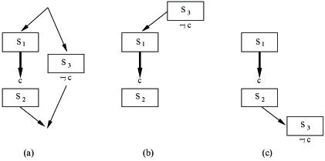
Clobbering and Promotion / Demotion
A clobberer is a potentially intervening step that destroys the condition achieved by a causal link
We can prevent clobbering by ordering the clobberer before (demotion) the start of the link or after (promotion) the end of the link

Slide 40
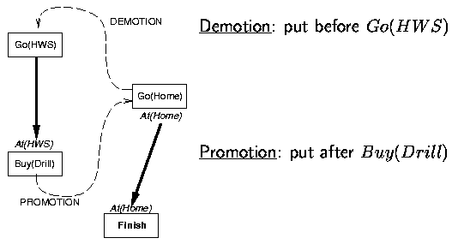
Example
In this example, Go(Home) clobbers At(HWS)

Slide 41
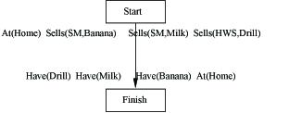
Example
Here is the shopping problem initial incomplete plan

Slide 42
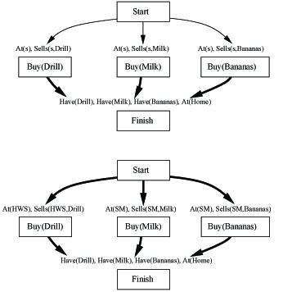
Example
The top plan achieves three of the four Finish preconditions, the heavy arrows show causal links. The bottom plan refines the top plan by adding causal links to achieve the Sells preconditions of the Buy steps.

Slide 43
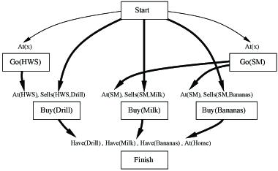
Example
This partial plan achieves the At preconditions of the three Buy actions.

Slide 44
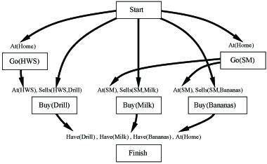
Example
This is a flawed plan for directing the agent to the hardware store and the supermarket.
There is no way to resolve the threat that each Go step poses to the other.
We now backtrack in the search process.

Slide 45
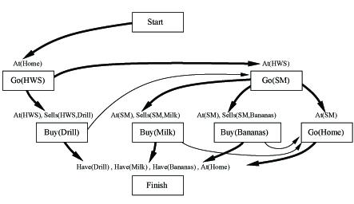
Example
The next choice is to achieve the At(x) precondition of the Go(SM) step by adding a causal link from Go(HWS) to Go(SM).
The Go(SM) step now threatens the At(HWS) precondition of the Buy(Drill) step, and is resolved by promotion.

Slide 46
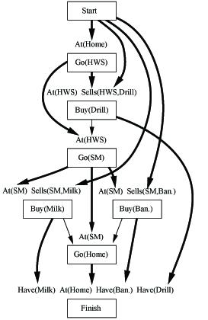
Example
The At(Home) precondition of the Finish step is still unachieved.
If the planner links At(Home) in the initial state to Finish, there will be no way to resolve the threats raised by Go(HWS) and Go(SM).
If the planner tries to link At(x) to Go(HWS), there will be no way to resolve the threat posed by Go(SM), which is ordered after Go(HWS).
The planner links Go(SM) to At(x), so x is bound to SM and Go(Home) deletes the At(SM) condition, resulting in threats to the At(SM) precondition for Buy(Milk) and Buy(Bananas). These threats are resolved by promoting Go(Home).
Here is the final plan.

Slide 47
Partial Plan
Plan 0
Steps: Start(0), Finish(1, pre=On(A,B), On(B,C))
Order: 0 before 1 (ignore bindings for now)
Links: none
Issues: Prec of 1 are not met. Try adding step.
0
1

Slide 48
Partial Plan
Plan 1 (sibling plan could be to add PutOn(B,C))
Steps: Start(0), Finish(1, pre=On(A,B), On(B,C))
PutOn(A,B)(2, pre=Clear(A), Clear(B))
Order: 0 before 1, 2 before 1
Links:
2 establishes On(A,B) for 1, order 2 before 1
No step removes On(A,B) so okay for now
0 establishes Clear(B) for 2, order 0 before 2
Issues: The other precondition of step 1 is not met.
Clear(B)
On(A,B)
0
2
1

Slide 49
Partial Plan
Plan 2 (sibling plans would address pre of step 2)
Steps: Start(0), Finish(1, pre=On(A,B), On(B,C))
PutOn(A,B)(2, pre=Clear(A), Clear(B))
PutOn(B,C)(3, pre=Clear(B), Clear(C))
Order: 0 before 1, 2 before 1, 0 before 2, 0 before 3, 3 before 2, 3 before 1
Links:
2 establishes On(A,B) for 1, order 2 before 1
0 establishes Clear(B) for 2, order 0 before 2
0 establishes Clear(B) and Clear(C) for 3, order 0 before 3
2 clobbers Clear(B), order 3 before 2
3 establishes On(B,C) for 1, order 3 before 1
No step removes On(B,C), okay for now
Issues: One precondition of step 2 is not met.
Clear(B)
On(B,C)
On(A,B)
0
3
2
1
Clear(B)

Slide 50
Partial Plan
Plan 3
Steps: Start(0), Finish(1, pre=On(A,B), On(B,C))
PutOn(A,B)(2, pre=Clear(A), Clear(B))
PutOn(B,C)(3, pre=Clear(B), Clear(C))
PutOn(C,Table)(4, pre=Clear(C))
Order: 0 before 1, 2 before 1, 0 before 2, 0 before 3, 3 before 2, 3 before 1, 0 before 4, 4 before 2, 4 before 3
Links:
2 establishes On(A,B) for 1, order 2 before 1; 0 establishes Clear(B) for 2, order 0 before 2
0 establishes Clear(B) for 3, order 0 before 3; 2 clobbers Clear(B), order 3 before 2
3 establishes On(B,C) for 1, order 3 before 1; No step removes On(B,C), okay for now
4 establishes Clear(A) for 2, order 4 before 2; No step removes Clear(A), okay
3 clobbers Clear(C), order 4 before 3
0 establishes Clear(C) for 4, order 0 before 4
Issues: NONE
Clear(A)
Clear(C)
Clear(B)
On(B,C)
On(A,B)
0
4
3
2
1
Clear(B)

Slide 51
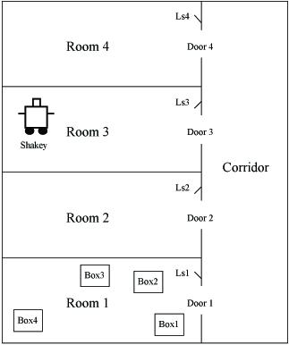
Shakey
STRIPS was originally designed to control SRI's Shakey robot, using the operators Go(x), Push(b,x,y), Climb(b), Down(b), TurnOnLight(s), and TurnOffLight(s).
The next generation - Flakey

Slide 52
Planning Graphs
More efficient and accurate planning technique.
The idea is to build a graph with n layers (the maximum plan length is thus n). Every level in the graph corresponds to a plan time step.
The initial state is level 0

Slide 53
Graph
Each level contains a set of propositions and a set of actions
Propositions at level i could be true in situation S_{i} depending on actions selected earlier
Actions at level i could be executed (preconditions satisfied), depending on which propositions are true in S_{i}
Every level i contains all literals that result from any possible choice of actions in the previous level
Constraints (negative interactions among actions) are noted

Slide 54
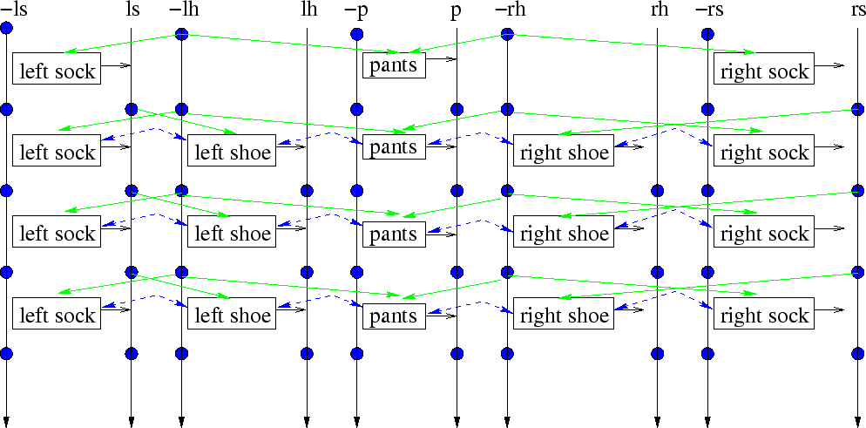
Example
Propositions
ls, rs (wearing left/right sock)
lh, rh (wearing left/right shoe)
p (wearing pants)
Actions
left/right sock preconditions = -ls/-rs, -lh/-rh delete = -ls/-rs add = ls/rs
left/right shoe preconditions = -lh/-rh, ls/rs delete = -lh/-rh add = lh/rh
pants preconditions = -p, -lh/-rh delete = -p add = p

Slide 55
Generating Planning Graph
First level is initial state
List possible actions, generate next level as resulting propositions
Persistence actions are used to represent propositions that remain true from one step to the next
Mutual exclusion (mutex) links connect actions that cannot co-occur
Mutex two actions if one action negatives an effect of the other (inconsistent effects)
Mutex two actions if one action effect is the negation of a precondition of the other action (interference)
Mutex two actions if the preconditions of the actions are contradictory (competing needs)
Mutex links also connect literals that cannot appear together
One literal is the negation of the other
The actions that generate the two literals are mutex (inconsistent support)
Continue generating graph until two consecutive levels are identical (graph has leveled off)
Alternatively, continue generating graph until a level contains the goal

Slide 56
Search Through Graph
One graph is generated, search backward from goal to initial state for plan.
Goals at time t
ls, rs, lh, rh, p
Select set of non-mutex actions at time t
pants, left sock, right sock
left shoe, right shoe
Goals at time t-1
-p, -ls, -rs, -lh, -rh, lh, rh These goals are contradictory, so cannot use
-lh, -rh, ls, rs, p

Slide 57
Search Through Graph
Select set of non-mutex actions at time t-1
left sock, right sock, pants
Goals at time t-2
-p, -ls, -rs, -lh, -rh
These are satisfied by initial conditions.
The final plan is
left sock, right sock, pants
left shoe, right shoe

Slide 58
Analysis
Efficient
Graphplan is Complete. If Graphplan does not generate a solution, then no solution exists.

Slide 59
Additional Planning Considerations
Resource Constraints
Conditional Planning
Monitoring / Replanning
Scalability GraphPlan

Slide 60
Planning in Practice
NASA New Millenium Program Programs on board spacecraft perform science planning and scheduling Execute plans without human intervention
Hitachi's O-PLAN Process planning and scheduling of 30-day assembly schedules
Desert Storm Planning Plan for transportation of troops, supplies, weapons

